Slide 1
Employee salary predictor
CAPSTONE PROJECT
Presented By:
NAME :- Rohan Gupta
COLLEGE :- IPS ACADEMY INDORE

Slide 2
OUTLINE
Problem Statement (Should not include solution)
System Development Approach (Technology Used)
Algorithm & Deployment (Step by Step Procedure)
Result
Conclusion
Future Scope(Optonal)
References

Slide 3
Problem Statement
This project focuses on building a predictive model to estimate employee salaries. It involves loading a dataset containing employee demographics, education, job details, and experience. The data is then cleaned and preprocessed, including handling missing values, removing duplicates, and encoding categorical features. A Linear Regression model is trained on this prepared data to learn the relationship between the features and salary. The model's performance is evaluated using standard regression metrics to understand its accuracy. Finally, the project demonstrates how to use the trained model for predicting salaries for new employees..

Slide 4
System Approach
The system approach uses Google Colab as the development environment. The key libraries used in this project are:
pandas: For data loading, manipulation, and analysis.
numpy: For numerical operations.
matplotlib.pyplot and seaborn: For data visualization.
sklearn (scikit-learn): For machine learning tasks, including:
LabelEncoder: For encoding categorical features.
StandardScaler: For scaling numerical features.
train_test_split: For splitting data into training and testing sets.
LinearRegression: For building the predictive model.
mean_absolute_error, r2_score, mean_squared_error: For evaluating the model's performance.
pickle: For saving and loading the trained model.
streamlit and pyngrok: For potentially deploying the model as a web application

Slide 5
Algorithm & Deployment
Load the dataset: Load the employee salary prediction dataset into a pandas DataFrame.
data = pd.read_csv('/content/Dataset09-Employee-salary-prediction.csv’)
Explore and understand the data: Check the shape of the dataset, identify missing values, and understand the data types of each column.
print(data.shape)
print(data.isnull().sum())
print(data.dtypes)
data.info()
Handle missing values and duplicates: Address missing values and remove duplicate rows to ensure data quality.
print(data[data.duplicated()].shape)
data1 = data.drop_duplicates(keep = 'first')
print(data1.isnull().sum())

Slide 6
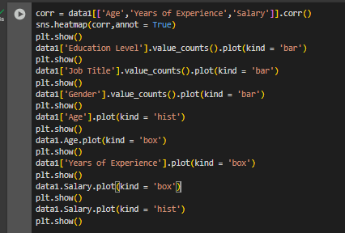
Data visualization
Visualize the data: Create visualizations to understand the distribution of key features like education level, job title, age, and salary, and to examine the correlation between numerical features.

Slide 7
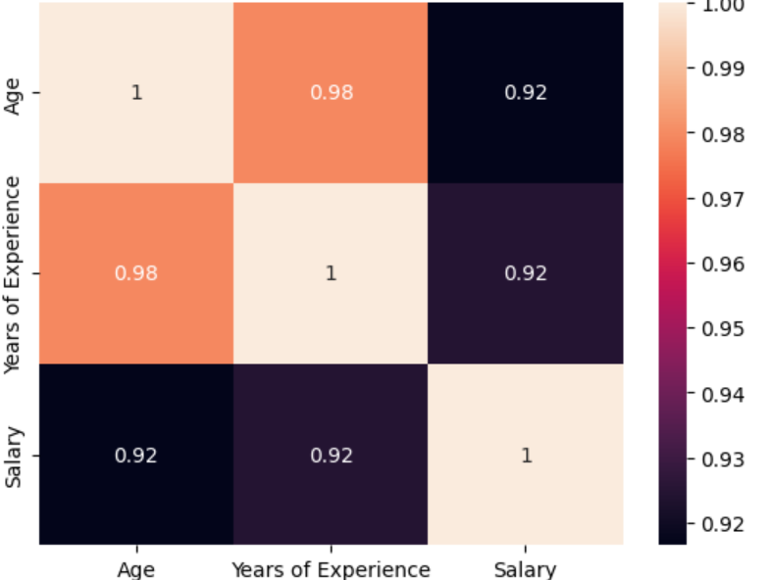
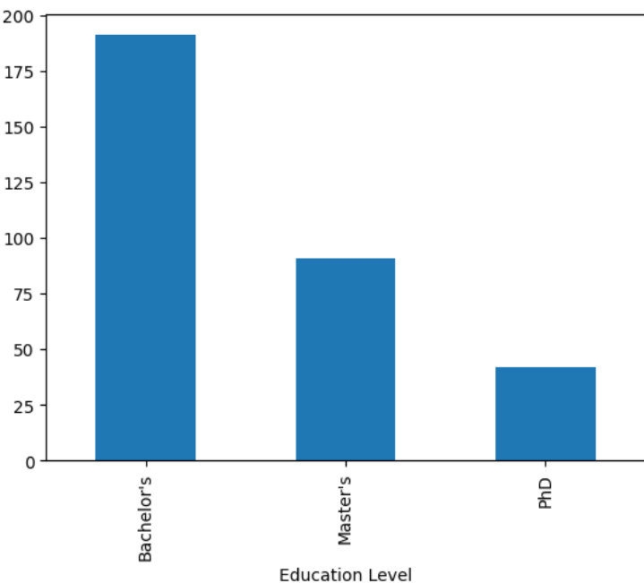
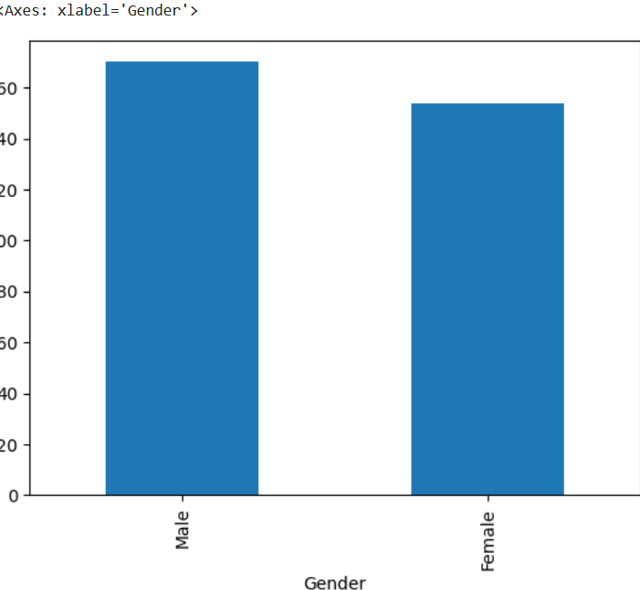
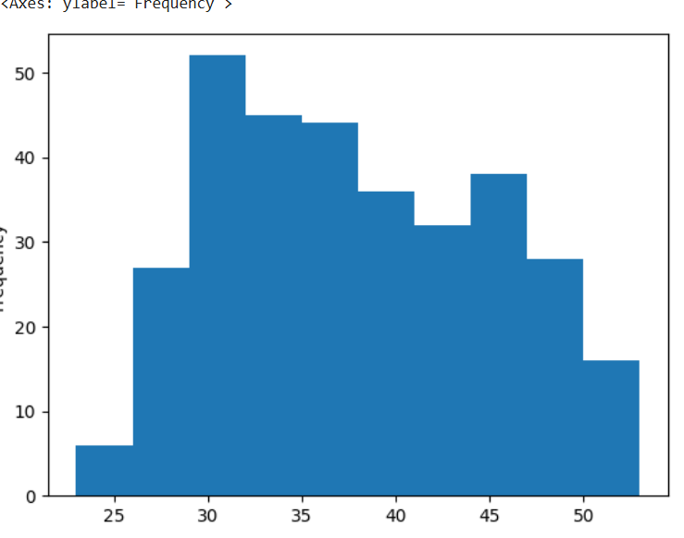
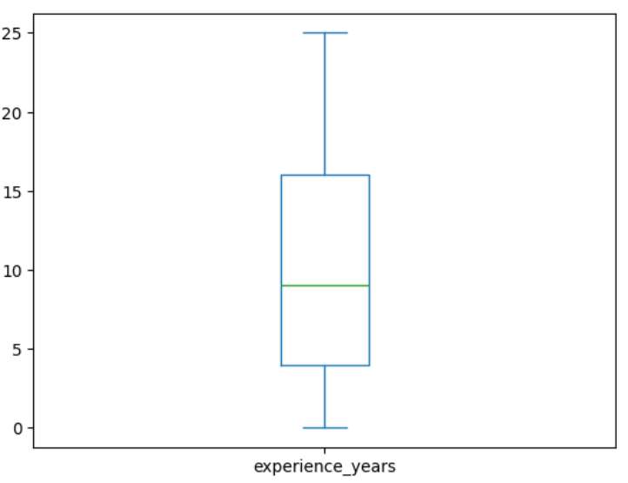
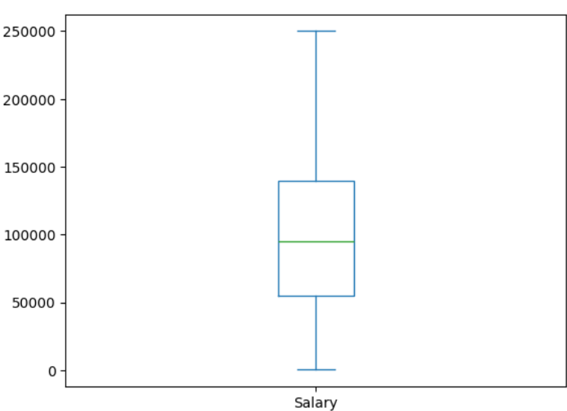
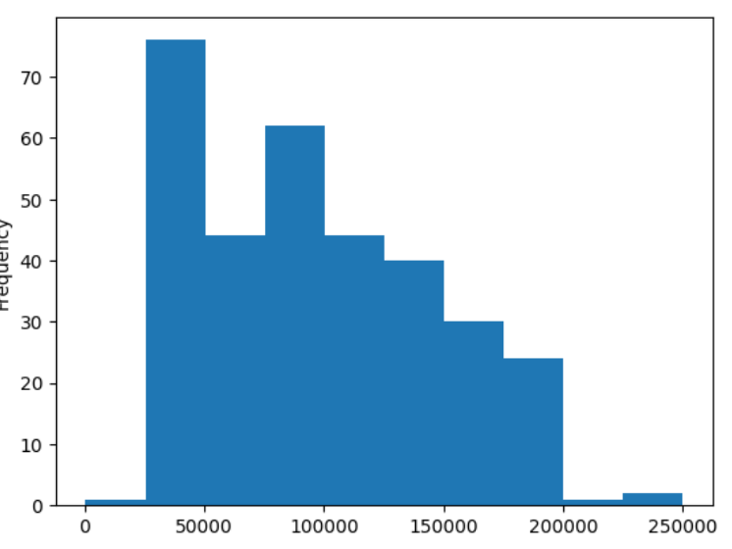
Visualization :

Slide 8

preprocessing
Preprocess the data: Encode categorical features and scale numerical features to prepare the data for model training.
Rename the specified columns in the data1 DataFrame.
Apply Label Encoding to the categorical columns and Standard Scaling to the numerical columns in the data1 DataFrame.

Slide 9
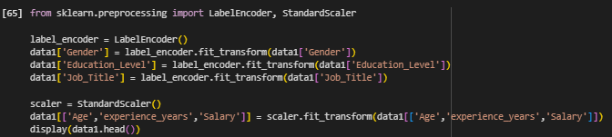
Apply Label Encoding to the categorical columns and Standard Scaling to the numerical columns in the data1 DataFrame.

Slide 10
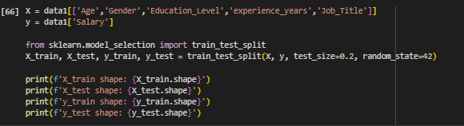
Split the data:
Split the data: Divide the dataset into training and testing sets.

Slide 11


Train a linear regression model
Train a linear regression model
Train a Linear Regression model using the training data.

Slide 12
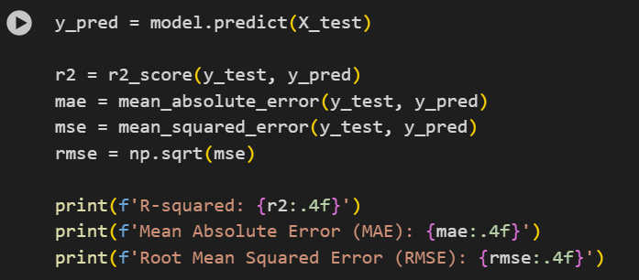
Evaluate the model:
Evaluate the model: Assess the performance of the trained model using relevant metrics like R-squared, Mean Absolute Error, and Root Mean Squared Error.\
Predict salary for the test set and calculate R-squared, MAE, and RMSE.

Slide 13
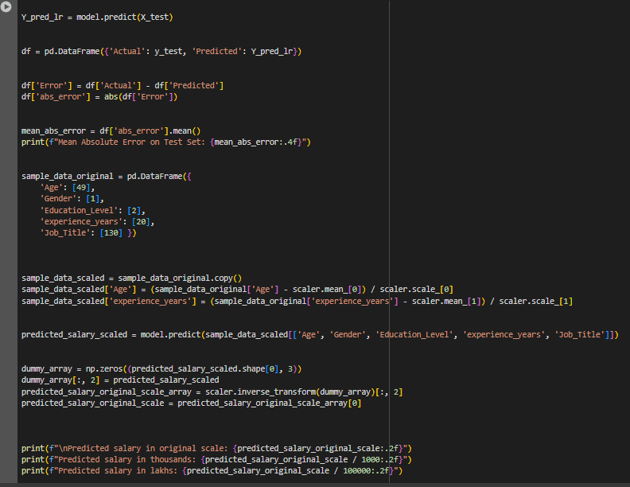
Make predictions
Make predictions: Use the trained model to make salary predictions on the test set and on new, unseen data.
Save the model: Save the trained model for future use.

Slide 14
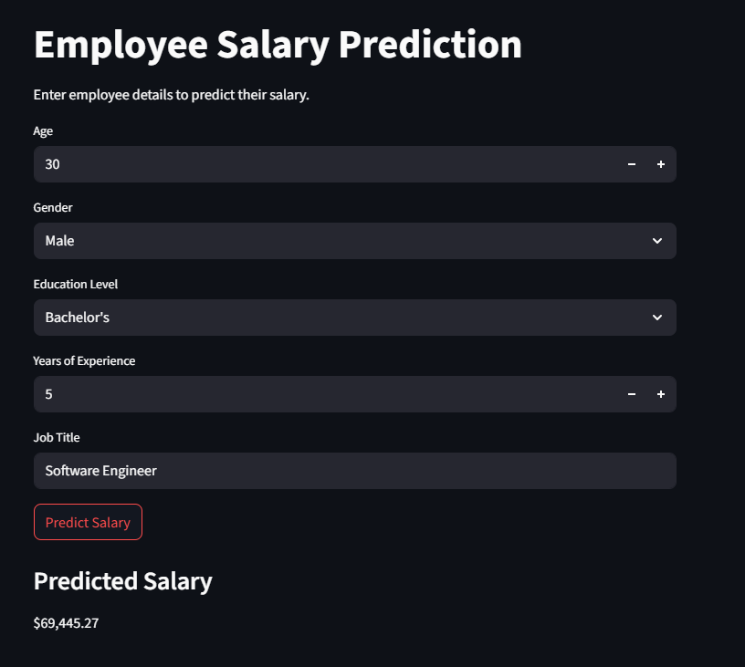
Result
https://github.com/rohan2RS/Employee_Salary_predictor.git
https://github.com/rohan2RS/Employee_Salary_predictor/tree/main

Slide 15
Conclusion
In conclusion, this project successfully developed a Linear Regression model to predict employee salaries based on relevant features. The model achieved a good R-squared score of approximately 89.11% on the test data, indicating its effectiveness in explaining salary variations. The trained model is saved and ready for potential deployment to make future salary predictions.

Slide 16
Future scope(Optional)
Explore other models: Investigate and compare the performance of other regression algorithms like Random Forest, Gradient Boosting, or Support Vector Machines to see if they yield better results.
Feature Engineering: Create new features from existing ones, such as combining education level and experience, or analyzing the impact of specific job titles in more detail.
Hyperparameter Tuning: Optimize the parameters of the chosen model(s) using techniques like GridSearchCV or RandomizedSearchCV to potentially improve performance.
Handle outliers: Further investigate and potentially handle outliers in numerical features like 'Age', 'Years of Experience', and 'Salary', as they can sometimes negatively impact model training.
Collect more data: A larger and more diverse dataset could lead to a more robust and generalized model.
Deploy the model: Build a user interface (like the attempted Streamlit app) to easily input new employee data and get salary predictions.
Analyze feature importance: Determine which features have the most significant impact on salary predictions to gain deeper insights into the factors influencing salary.

Slide 17
References
https://www.youtube.com/watch?v=qNl9IvkCl8o

Slide 18
THANK YOU

